Slide 1
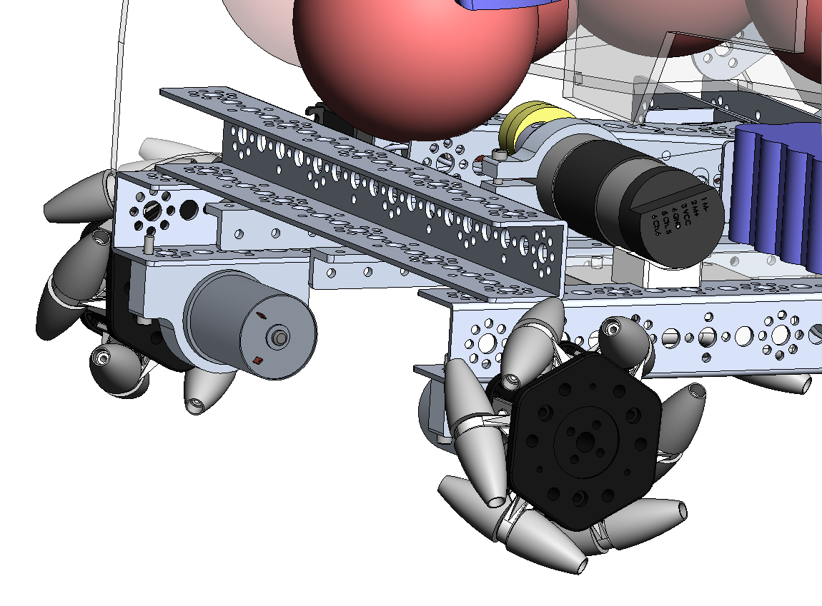
Motor Mount
Previously the team mounted the Mech Wheels onto the motor shafts, and attached the motors to the bottom of the frame channel. The motors were stressed, the frame was raised way off the floor.
Previously the team mounted the Mech Wheels onto the motor shafts, and attached the motors to the bottom of the frame channel. The motors were stressed, the frame was raised way off the floor.
Issues: Lower the frame
Offset the motors – not direct drive
Provide room between motors for wiring
Lower the wheels motors – clearance for Flip motor travel
Provide room at front for GeoGrabber
Concept – Mech Wheels
12.30.2017
Last year – wheel mounting
12.30.2017

Slide 2
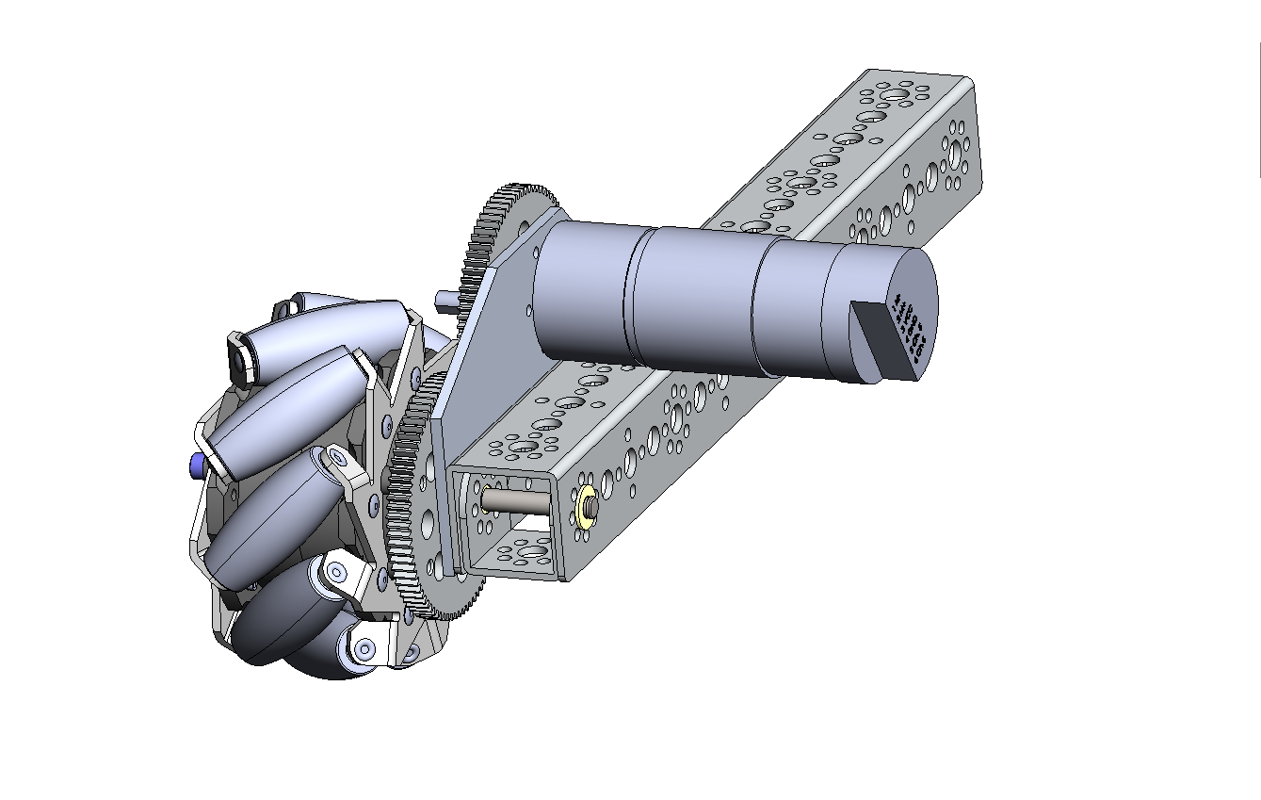
We need to lower the frame to accommodate the vertical axis and GeoGrabber.
This is a concept for mounting the wheels to provide more room.
Issues: Lower the frame
Offset the motors – not direct drive
Provide room between motors for wiring
Lower the wheels motors – clearance for Flip motor travel
Provide room at front for GeoGrabber
Concept – Mech Wheels
12.30.2017

Slide 3
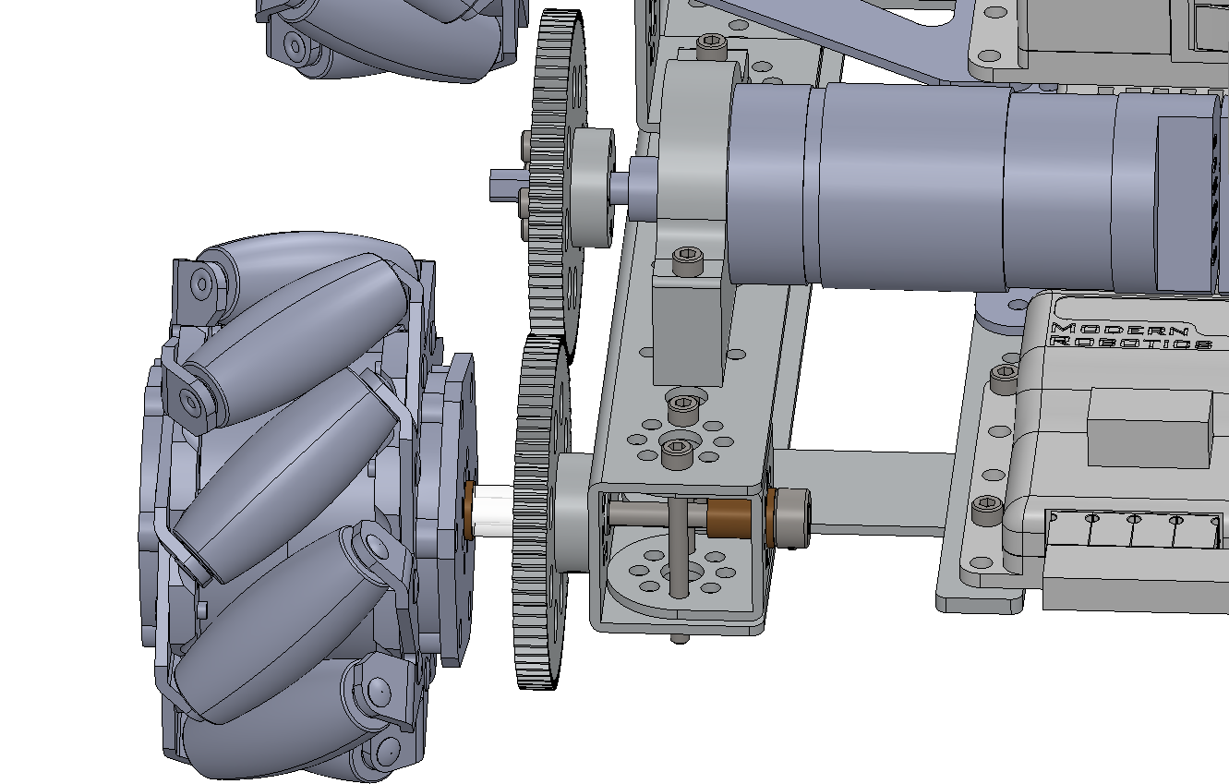
Nice: Lowers the frame
Offsets the motors – not direct drive
Provides some room at front for GeoGrabber
Easy to remove wheels
Standard kit parts
This is an early concept with some nice things and some issues. Todays concept is a re-thinking of this concept to address the issues and build on the nice.
Not nice: Very long slim shaft – bendie.
Wheels a long way from the frame – larger footprint, less maneuverable.
No room between motors for wiring
Wheels motors are high - no clearance for Flip motor travel
Early Concept –Wheels
12.30.2017

Slide 4
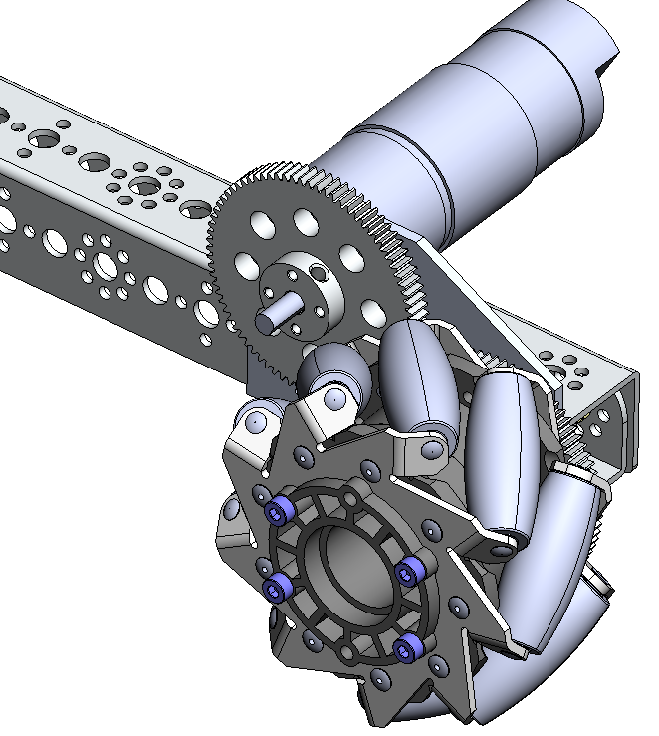
Custom motor mount plate with spacers –
Mounts to the side of the channel.
Countersink holes in gear – room for screw heads taken by motor mount plate.
Concept – Mech Wheels
12.30.2017

Slide 5
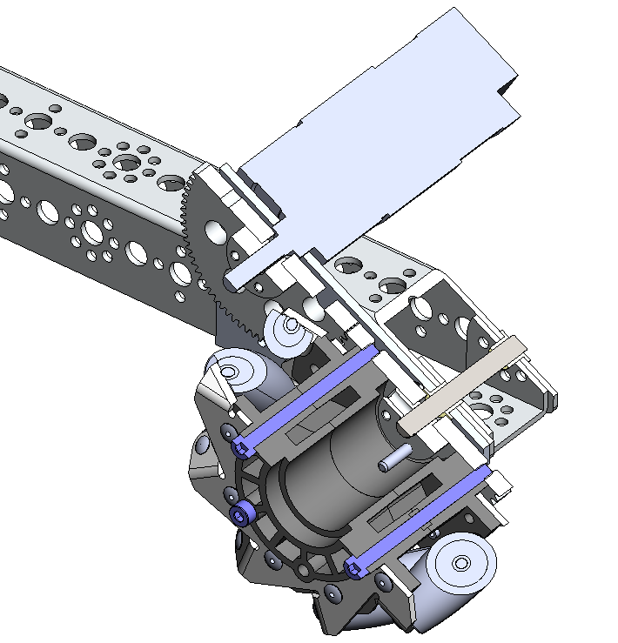
Bigger 6mm shaft with e-rings (not shown)
Plastic flange bushings like used for flip shaft.
Long M4 screws to mount gear directly to the wheel. No hex plate is used.
Gear – drill and tap for long screws. Countersink screw holes for mounting to collar. Room for screw heads taken by motor mount.
Flat head screws to mount gear to collar
Concept – Mech Wheels
12.30.2017

Slide 6
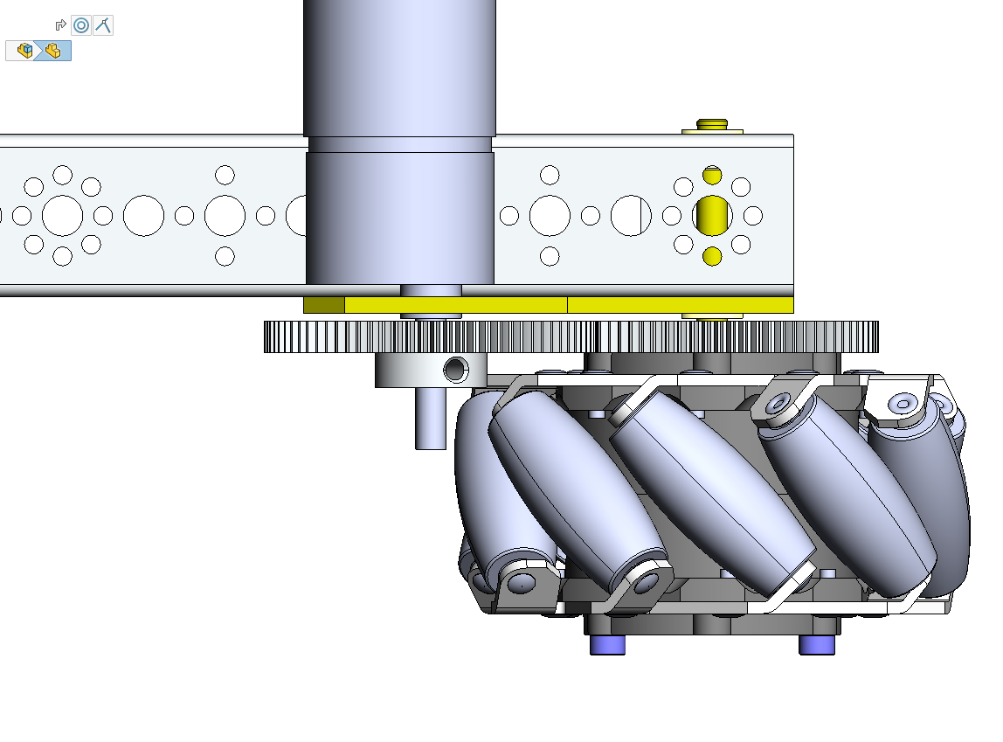
Plastic flange bushings like used for flip shaft.
Custom motor mount plate with spacers –
Mounts to the side of the channel.
Bigger 6mm shaft with e-rings (not shown)
Gear mounted directly to the wheel. No hex plate is used.
Concept – Mech Wheels
12.30.2017

Slide 7
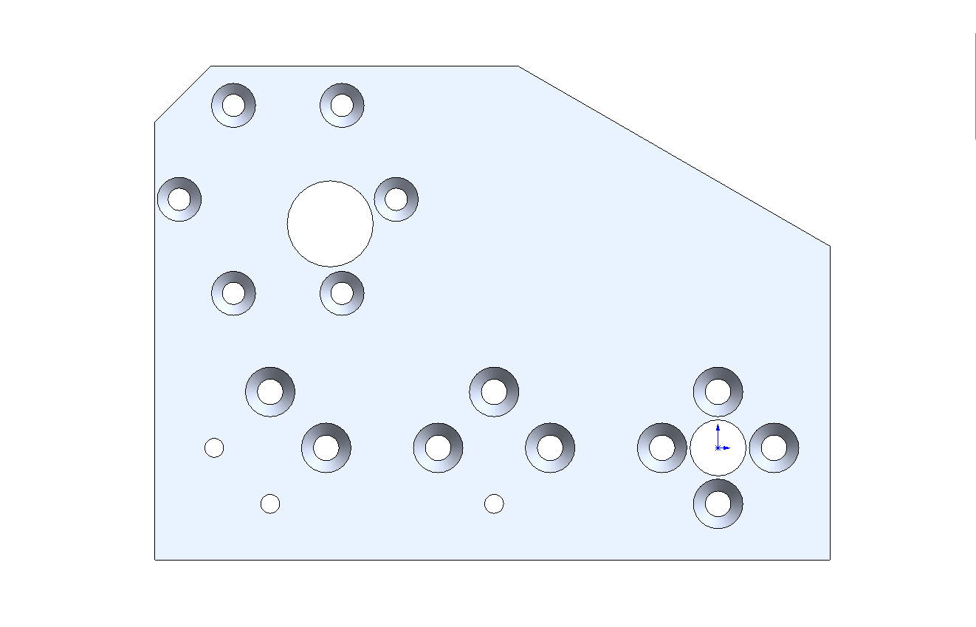
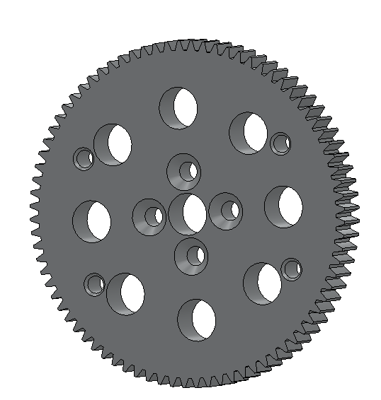
Custom motor mount
4 needed, 2 left, 2 right
Mod to gear – tap M4 & Countersink holes.
Concept – Mech Wheels
12.30.2017

